Slide 1
Comfort Kits for Everyone!
Tim Culbert, MD
Karen Olness, MD

Slide 4
Mapping: Symptoms X Therapies
Pain
Imagery, breathing
HRV biofeedback
Acupressure
[energy, massage, music rx]
Anxiety & Insomnia
PMR, breathing, biofeedback
Aromatherapy (lavender, sweet orange)
[energy, massage, music and art rx]
Nausea
Acupressure
Aromatherapy (spearmint, lemon, peppermint)
Hypnosis, breathing
[acupuncture]

Slide 5
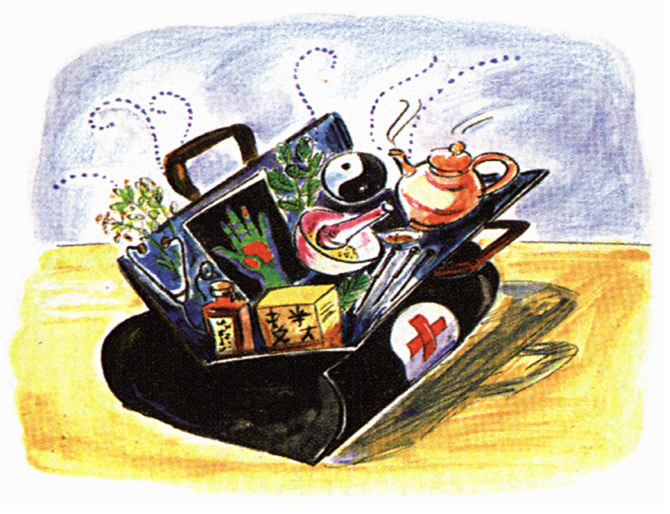
Our Team

Slide 6
Self-Care Toolkits: Tools
Acupressure-pencil erasers, massage pens
Aromatherapy-0ils or patches
Distraction/Art Therapies
Mind/Body Skills
Breathing-pinwheels and bubbles
PMR-stress ball
Imagery-glitter wand
Biofeedback-biodots, dermatherms, gadgets
*Classic Video-No Tears, No Fears
Rewards
Stickers, toys, certificates
Sleep
Delta Sleep System CD’s or iPOD
High Tech
iPad, Alpha Stim, AVE, BF computer for ward

Slide 7
Self-Care Toolkits: Techniques
Patient Handouts
Breathing
Progressive Muscle Relaxation
Imagery and Meditation
Positive Self-Talk
Aromatherapy Info
Acupressure Point Locations
Calendars
Parent Coaching Tips/Role in Self-Reg

Slide 8
Comfort Kit for Kids & Families
Best of currently available psychological/behavioral strategies
Self-care design
Booklet for kids with “exercises”
Booklet for parents to be good coach
Items to make it fun
Trial of 100 kids (day surgery)

Slide 9
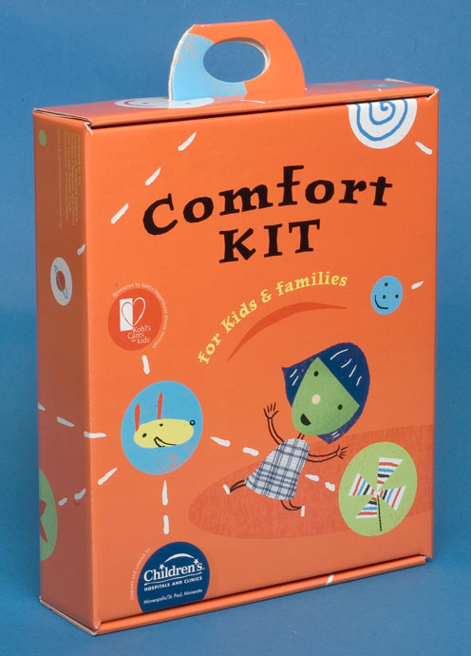

Slide 10
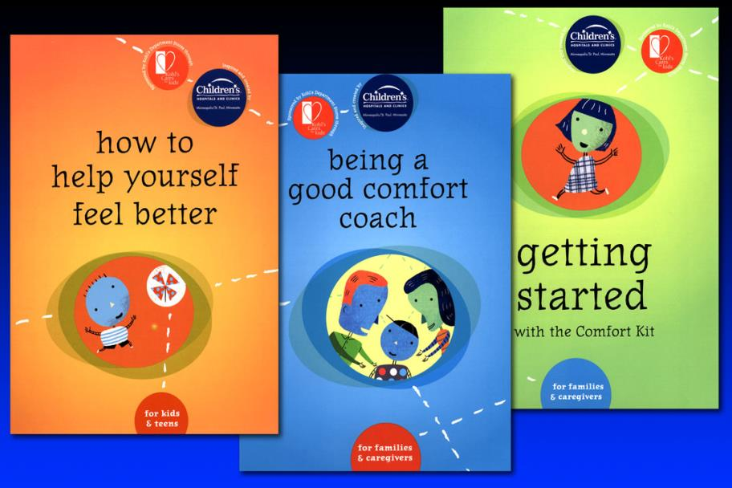

Slide 11
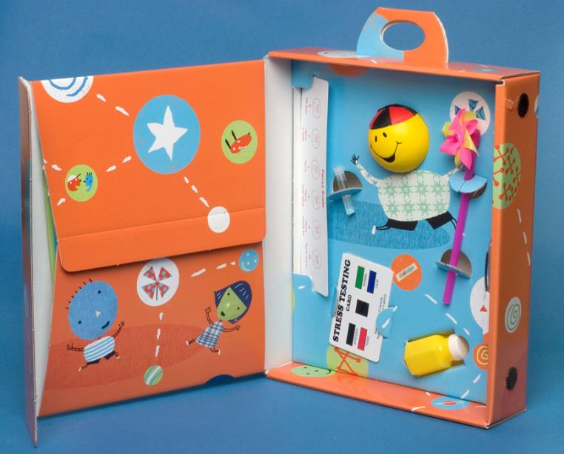

Slide 12
Pilot Study
132 kits out, 63 to kids, 56 parent responses (89% response rate)
Inpatient and Outpatient
Mailed for day surgery kids 2 weeks prior to procedure
Brief telephone survey

Slide 13
Day Surgery
Tonsillectomy
Adenoidectomy
Hernia Repair
Orchiopexy

Slide 14
Pilot Study Preliminary Results
How Helpful was the Kit in Helping you/your child cope with pain and distress?
Parents: n=56
Very Helpful: 31%
Somewhat Helpful: 59%
Not at all: 5%

Slide 15
Pilot Study Preliminary Results II
Would you Recommend this Kit to Another Family?
Parents:
Yes: 89%

Slide 16
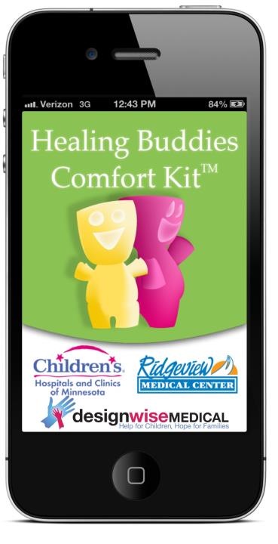

Slide 17
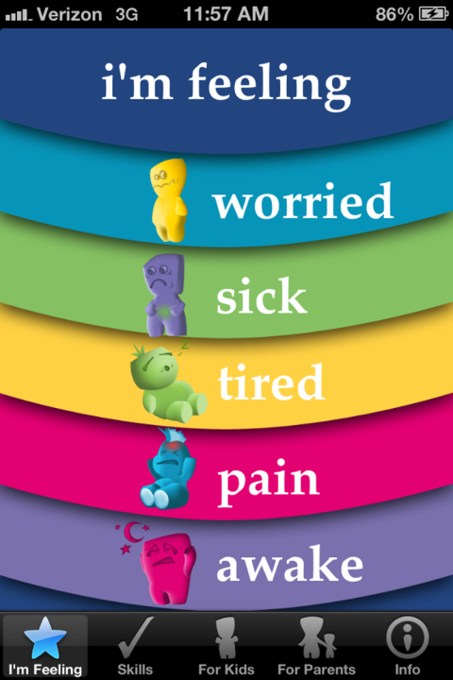

Slide 18
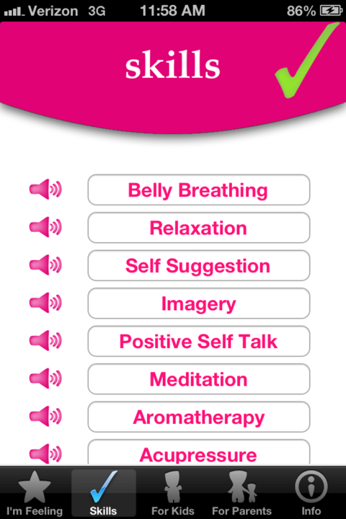

Slide 19
Phase I
Discuss responsibilities of partnership and financial commitment and payout
Redesign logo and brand standards
Determine if website, landing page, etc. is necessary at this phase
Create “Sell Sheet" to access grant funding
Design a smaller, most cost-efficient version of Comfort Kits for humanitarian aid
obtain grant money to begin production of kits – (already in process?) Brainstorm on this if not. Discuss product design, items that go inside, distribution methods, etc.

Slide 20
Mini Comfort Kit Contents
Contents may vary depending on supply and availability
Crayons
Notebook
Symptom Management Ruler
Comfort Kit Skill Cards
Toy (donation - Toys for God’s Kids)
Packaged in small package (possible reusable item)
Other items as developed
Aromatherapy?
Acupressure tool
Instructions sets for kids and parents and healthCare Staff

Slide 21
Phase II
Design Comfort Kit and specifications
Develop case study and "sell sheet" for an updated Comfort Kit
Brainstorm to determine which associations to connect with
Production of 3,000 to 5,000 kits (total quantity will depend on funding and/or presale)
Distributed to clinics and other markets as determined

Slide 22
Comfort Kit Contents Other Options
Contents may vary depending on supply and availability
Comfort Kit Voice Tracks
Small stuffed animal
Symptom Management Ruler
Sea Band
Comfort Kit Skills Card
Aromatherapy Oils
Acupuncture pen
Mini fan
Workbook
Pedometer
Other items as developed or refined

Slide 23
Phase III
Brainstorm direction – sales distribution, bring to market, etc.
Identify other products to be included
Establish website, web store and landing page
Photograph existing products (Comfort Kit and book set) and get them online
Sell sheets to distribution points like hospital association groups, therapy clinics and retail to support margin to create and donate the free kits

