Slide 1
Helping children and families who experience disasters
KAREN OLNESS MD, FAAP, PROFESSOR EMERITA OF PEDIATRICS, GLOBAL HEALTH AND DISEASES, CASE WESTERN RESERVE UNIVERSITY
With assistance from TIMOTHY CULBERT, MD

Slide 2
Drawings by displaced children in Kosovo

Slide 3
Drawing by children in refugee camp, Sudan

Slide 4
Help children to feel in control
Mental Health Professionals are always in short supply in acute disaster situations.
Interventions for pre-school and school age children should be culturally acceptable, should involve play and should be fun.

Slide 5
Programs to help children feel in control and facilitate resilience
COMFORT KITS
RETURN TO HAPPINESS
CHILD TO CHILD
BIOFEEDBACK PROGRAMS SUCH AS HEART MATH, and THOUGHT TECHNOLOGY.
SCORES OF RELAXATION, MINDFULNESS, GUIDED IMAGERY APPS FOR PHONES AND COMPUTERS.

Slide 6
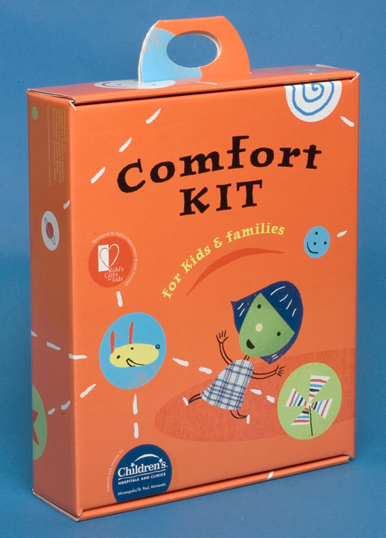
THE ORIGINAL COMFORT KIT, Children’s Hospital in Minneapolis, Minnesota
Developed by Tim Culbert MD, Maura Fitzgerald, RN, CNS and Lynda Richsmeier Cyr, PhD at Minneapolis Children’s Hospital.
Purpose to help hospitalized children, especially those with chronic illnesses who had problems of anxiety, pain, or sleep.
Questionnaire study of parents indicated that children benefitted and continued to use the kits at home.

Slide 7
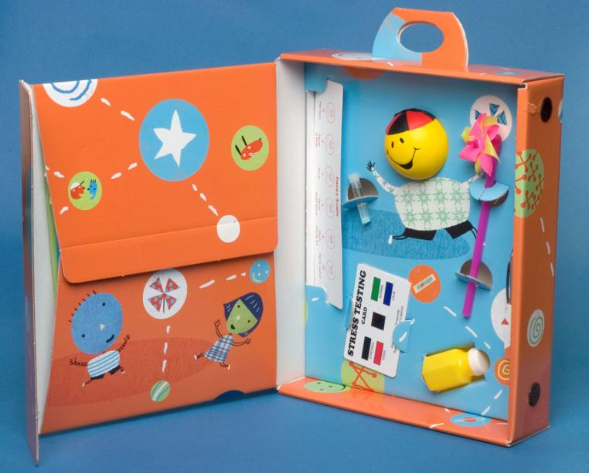
Original Comfort Kit
Squeeze Ball
Bubbles
Aroma therapy
Pinwheels
Stress Test reflecting finger tip temperature – “Dermatherms”

Slide 8
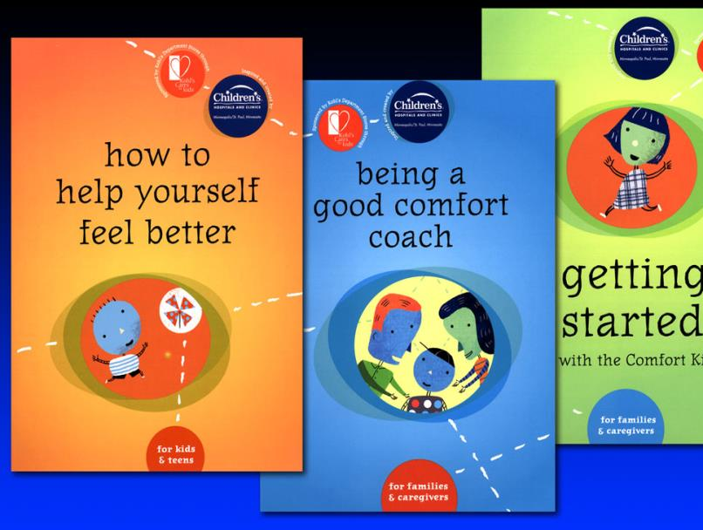
Instructions in each kit
Instructions for the comfort coach who might be a parent, grandparents or nurse.
Emphasis on child choice, personal control and self care.

Slide 9
Example of how to practice a skill
Breathe to Relax
Imagine you have a balloon in your tummy.
Breathe in slowly through your nose
Breathe out slowly through your mouth
Feel your tummy get big like a balloon blowing up as you breathe in.
As you breathe out, you can let go of uncomfortable feelings or stress.

Slide 10
Comfort kits adapted for use in both man-made and natural disasters
Dr. Srivieng Pairojkul, a Thai pediatrician, found appropriate items, assembled into kits, adapted and translated instructions and distributed to thousands of children after tsunami.

Slide 11
Mini Comfort Kit Items that have worked well in small kits
CONTENTS VARY DEPENDING ON LOCALE AND AVAILABILITY OF ITEMS
SMALL BOX OF CRAYONS, SMALL NOTEBOOK
FINGER PUPPET OR OTHER TOY
PINWHEELS
6 INCH RULER TO HELP SYMPTOM MANAGEMENT
BIODOTS, DERMATHERMS
ACUPRESSURE PEN or PENCIL ERASER
SQUEEZE BALL, FIDGET TOOLS, A PIECE OF STRETCHY STRING OR SILLY STRING
CARDS WITH INSTRUCTIONS ON HOW TO USE ITEMS, STICKERS
PLACE ALL IN SMALL CONTAINER THAT MIGHT BE RE-USED.

Slide 12
Instructions included in comfort kits
Breathing exercises
Progressive Muscle Relaxation (for older children and adolescents)
Imagery and Meditation
Positive Self-Talk
Acupressure Point Locations
Parent or Caretaker Coaching Tips/Role in Self-Regulation

Slide 13
Comfort Kit instructions translated into Creole for use in Haiti
Haitian child psychologist instructed teenagers on how to offer and explain comfort kits to younger children.
They gave the younger children choices with respect to which item they preferred.
They did breathing demonstrations for the younger children.

Slide 14
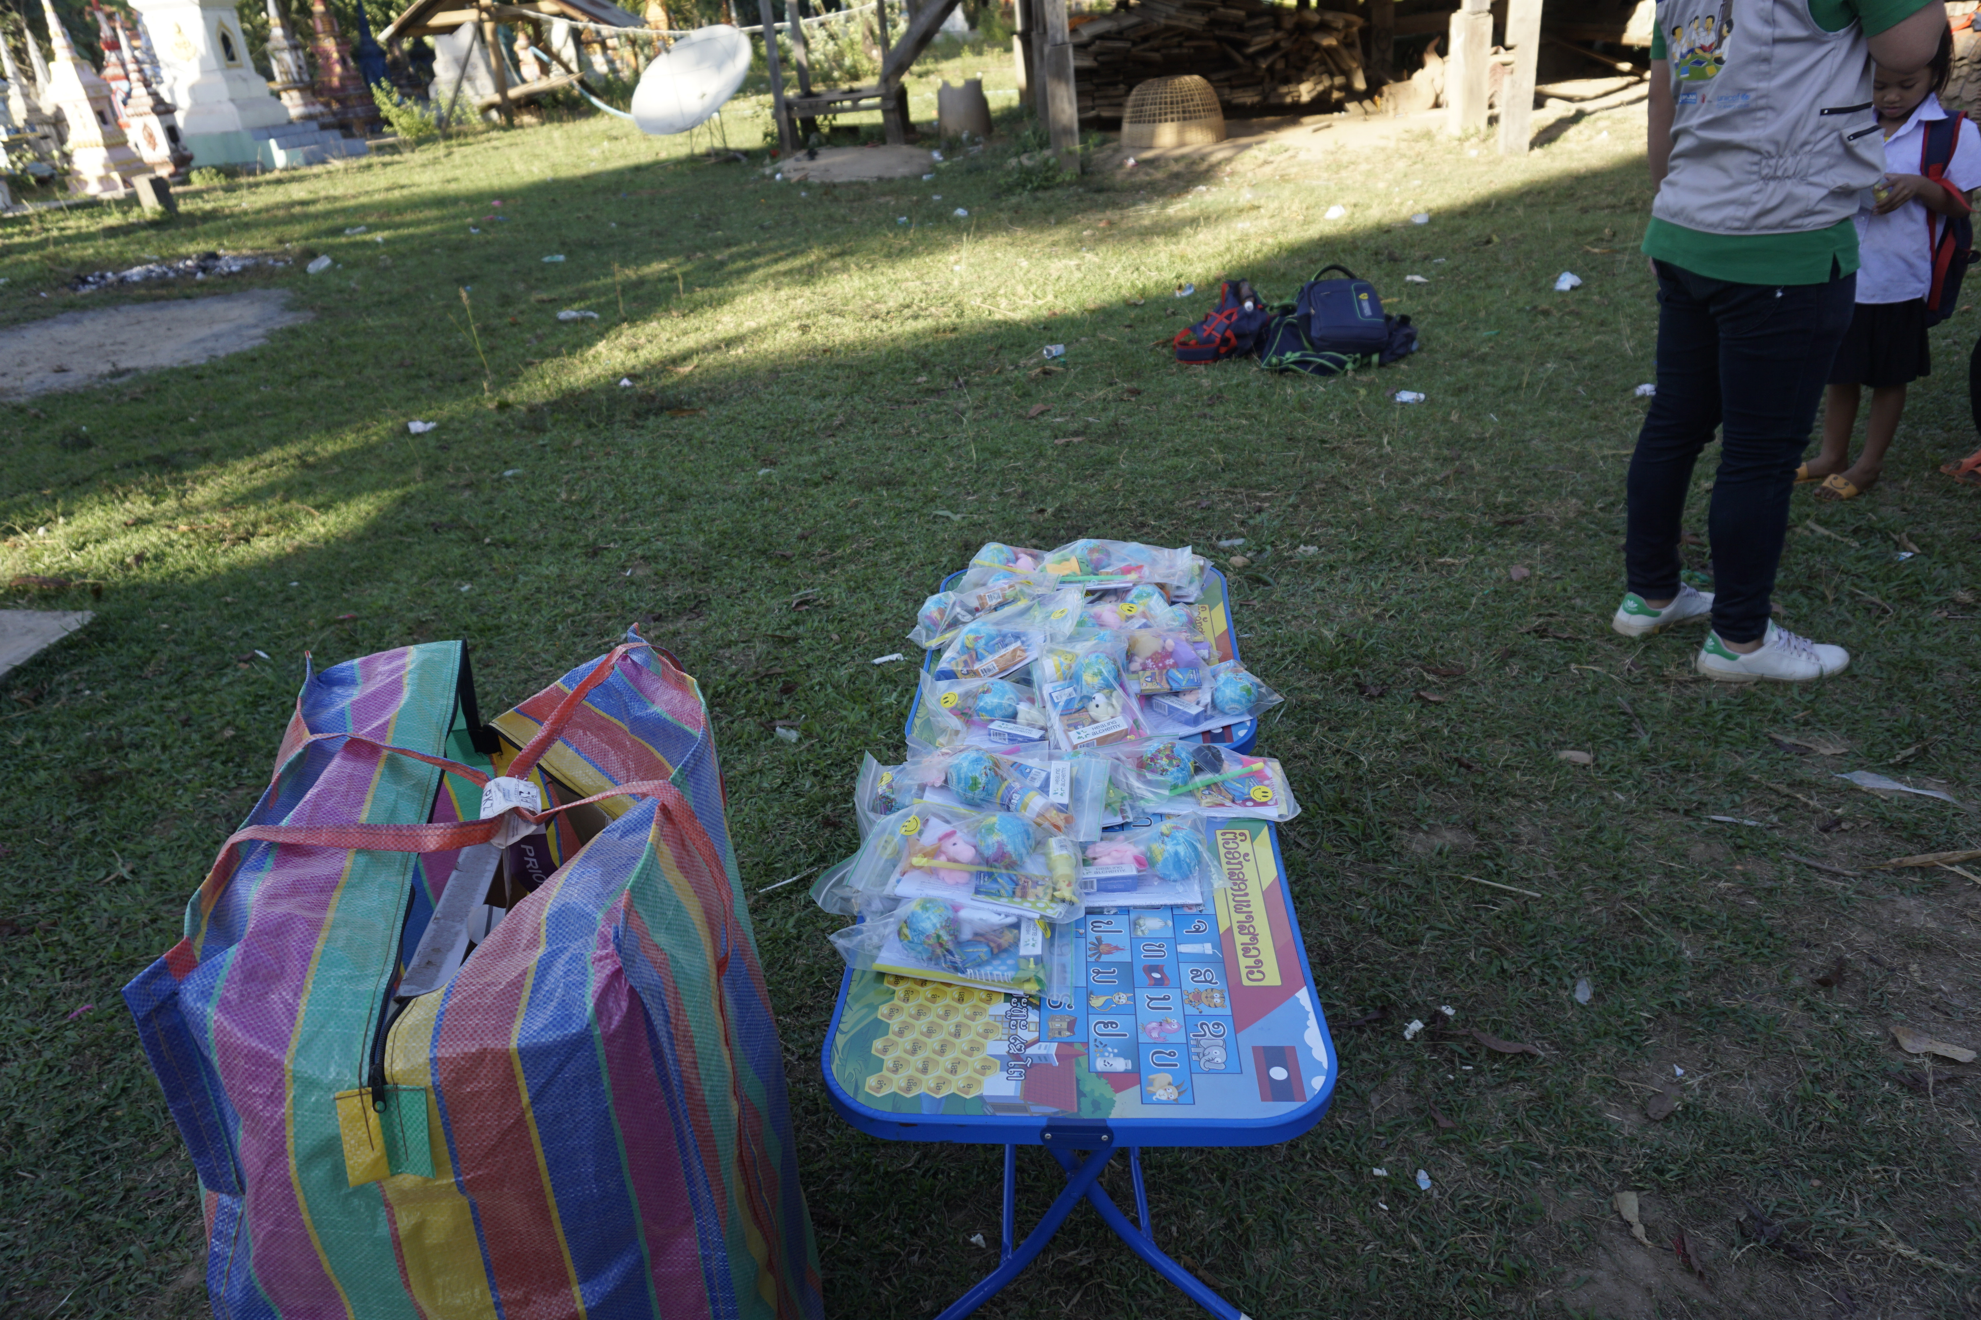
LAOS
Hundreds of children displaced by floods in southern Laos in 2018.
Comfort kit instructions translated into Lao.
They were distributed via schools established for displaced children.

Slide 15
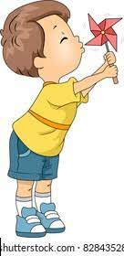
The Pinwheel-a device to control
GOOD EXAMPLE OF BEING IN CONTROL.
“I SEE THAT YOU MAKE THE PINWHEEL TURN FASTER OR SLOWER. YOU ARE IN CONTROL. THAT’S GOOD”.
“I HOW WELL YOU CONTROL YOUR BREATHING WHEN YOU BLOW”.

Slide 16
Finger puppets can tell stories
Finger puppets talk
They are in control

Slide 17
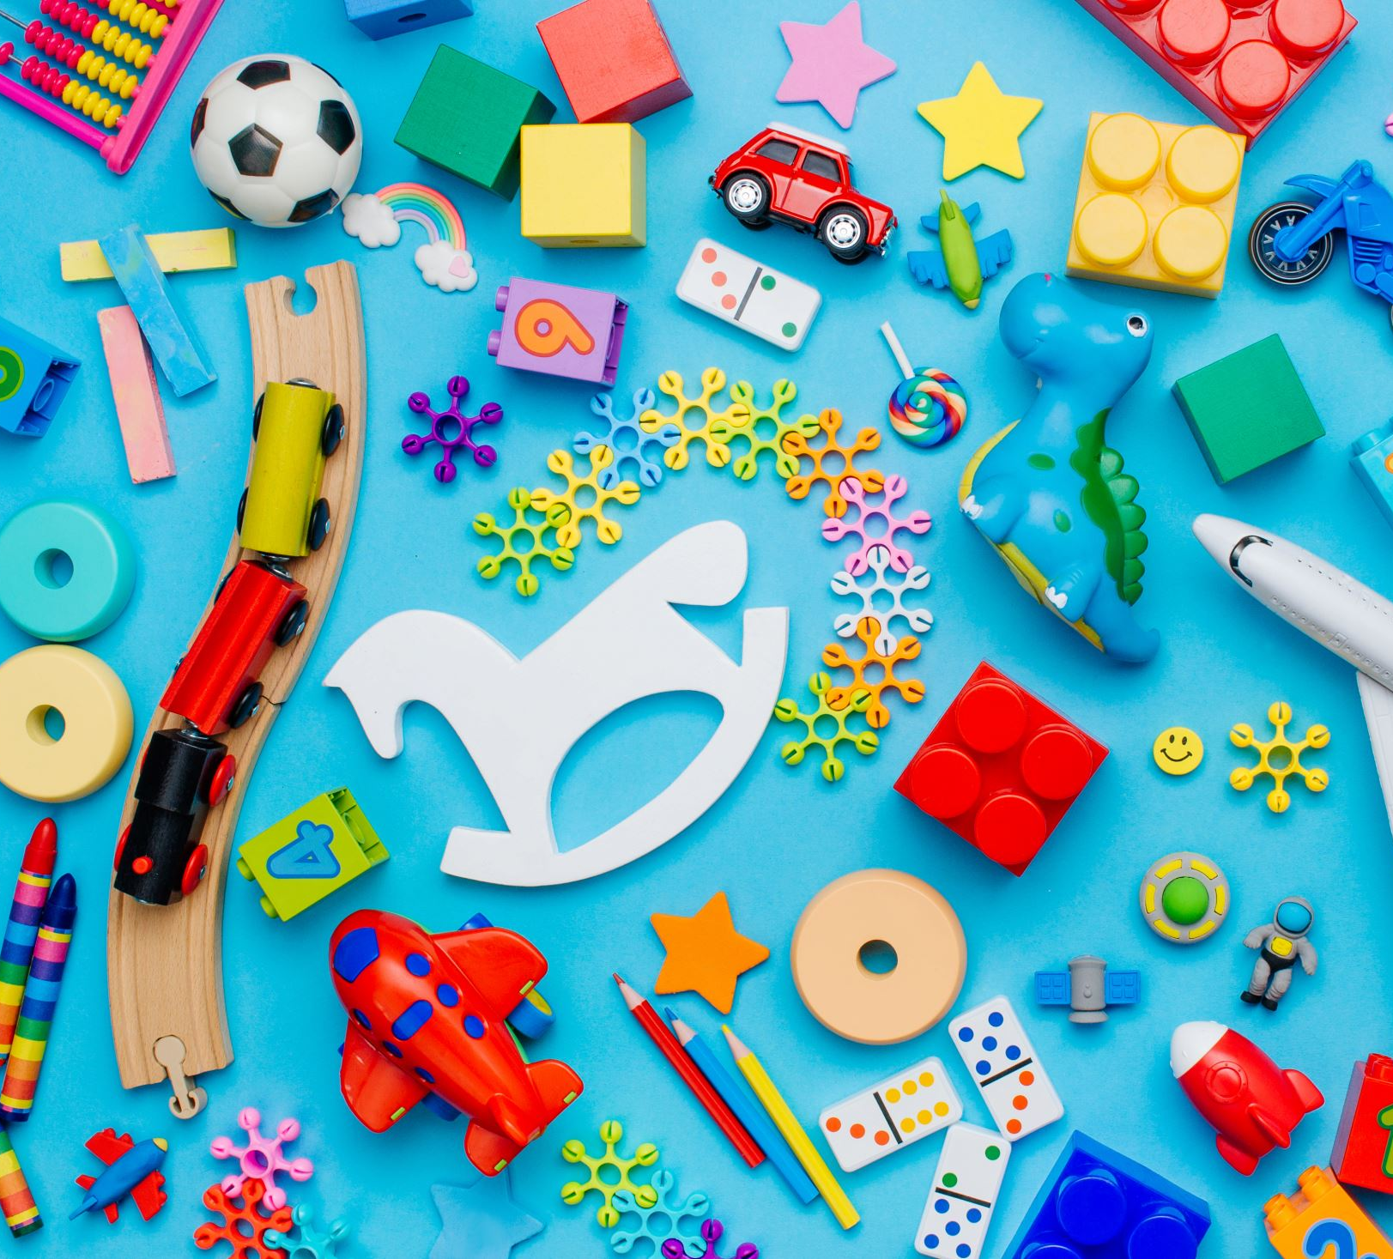
Encouraging children with simple toys
LOOK FOR ITEMS THAT PROVIDE WAYS TO HELP THE CHILD FEEL IN CONTROL.
ITEMS SHOULD BE DEVELOPMENTALLY APPROPRIATE.
AVOID ITEMS THAT CAN BE SWALLOWED BY SMALL CHILDREN.

Slide 18
An idea that has traveled well
Information about comfort kits can be accessed on website of International Pediatric Association.
https://www.ipa-world.org
SAGs- 2019-2021
Resources
Comfort Kit Information and Skill Practices
Also available on _____________________________

Slide 19
Return to Happiness Program
Developed by UNICEF
First used in Mozambique
Has been adapted for many areas of world
Involves communities, including teachers and other community leaders.
Process enjoyed by children and helps to identify children in need of psychological assistance.

Slide 20
Psychosocial Backpacks
For infants, toddlers:
Books
Teddy bears, baby dolls
Puppets, toy families
Art supplies: paper, crayons, scissors
For older children:
Chapter books
Blank books for journaling
Drawing/Art supplies

Slide 21
BOOKS FOR CHILDREN DISPLACED BY DISASTERS
SAN AGUSTIN M, RAMOS-BONOAN C, LORENZANA R, KLASS P, NEEDLEMAN R. PICTURE BOOKS AND READING ALOUD TO SUPPORT CHILDREN AFTER A NATURAL DISASTER: AN EXPLORATORY STUDY. INT J EMERGENCY MENTAL HEALTH HUMAN RESILIENCE, 2018: 21: 1-6.

Slide 22
CHILD to CHILD in emergencies
Child-to-Child is an educational process that began in 1978. (Dr. David Morley)
Child-centered participation
One child or a group of children teach a younger child/children or same age children
Children work together with the community

Slide 23
Child-to-Child in Afghan refugee camps in Pakistan
The community worker in the refugee camp, through a story, explained to children(5-10 years) the importance of talking to and playing with babies for the child’s development.
The older children went back to their young siblings to observe what made them smile.

Slide 24
Afghan refugee children planned action
They decided to make toys for children out of materials that did not cost anything:
String, paper, grass, bottle tops, cotton reels, old magazines
They made mobiles of shiny things and rattles for babies, shape sorters, picture books for very young children, pull along toys and puppets for toddlers.

Slide 25
Humanitarian Aid in Hostile Areas
Civilians, including health care professionals, may be targeted.
Hospitals and clinics may be bombed.
Between 2011-2017 more than 700 physicians and other health workers died in Syria while trying to help.
Flugelman AA and Barthoum MB. Humanitarian Aid Bridging Across a Hostile Border. Pediatrics 140:1-3, 2017.

Slide 26
Avoiding Relief Worker Trauma
Do your best to understand your duties and expectations of the overall program.
Participate in a “Buddy” system. Your Buddy is someone you trust who looks out for you and vice versa.
Plan to take breaks. Follow rules for shifts and time away.
Learn and practice a self regulation strategy.
Be sure there is an evacuation plan for you.
After completion of assignment, participate in debriefing.

Slide 27
We are guilty of many errors and many faults, but our worst crime is abandoning the children, neglecting the fountain of life.
Many of the things we need can wait.
The child cannot.
Right now is the time his bones are being formed, his blood is being made and his senses are being developed.
To him we cannot answer “Tomorrow”,
His name is “Today”.
Gabriela Mistral Nobel Prize-winning poet from Chile
Notes:
27
I’d like to end with this favorite piece written by Gabriela Mistral a nobel prize-winning poet from Chile.

